Slide 1
Volatility Analysis of Banking sector
Authors: Antonio Antona & Laura Tassi
Subject: Financial Econometrics
Supervisor: Arnauld Gloter

Slide 2
Introduction
The aim is to test if the volatility was higher, during the years 2009-2011, in the sector of banking, than for other sectors. Thus, we will do a statistical test for the equality of the volatility between two time series. It should be taken into account that the squared returns exhibit correlations, and thus the usual statistical test for equality between the means of two i.i.d. Sequences should be modified accordingly. In particular, it is asked to compute the p-value of the test result. The data of the stock prices may be found on the internet (on the yahoo site for instance).

Slide 3
Our choices:
French bank: we chose the BNP Paribas, one of the largest European banks.
This 2008 crisis also had repercussions in the following years especially in 2010, when BNP Paribas was the most affected bank in Europe and when the European Central Bank agrees to save European banks.
The general index chosen for our analysis is the CAC40, as suggested by our exercise, that is the index made up of the largest 40 companies listed in France screened by market capitalization, trading activity, size of balance sheet, and liquidity.

Slide 4
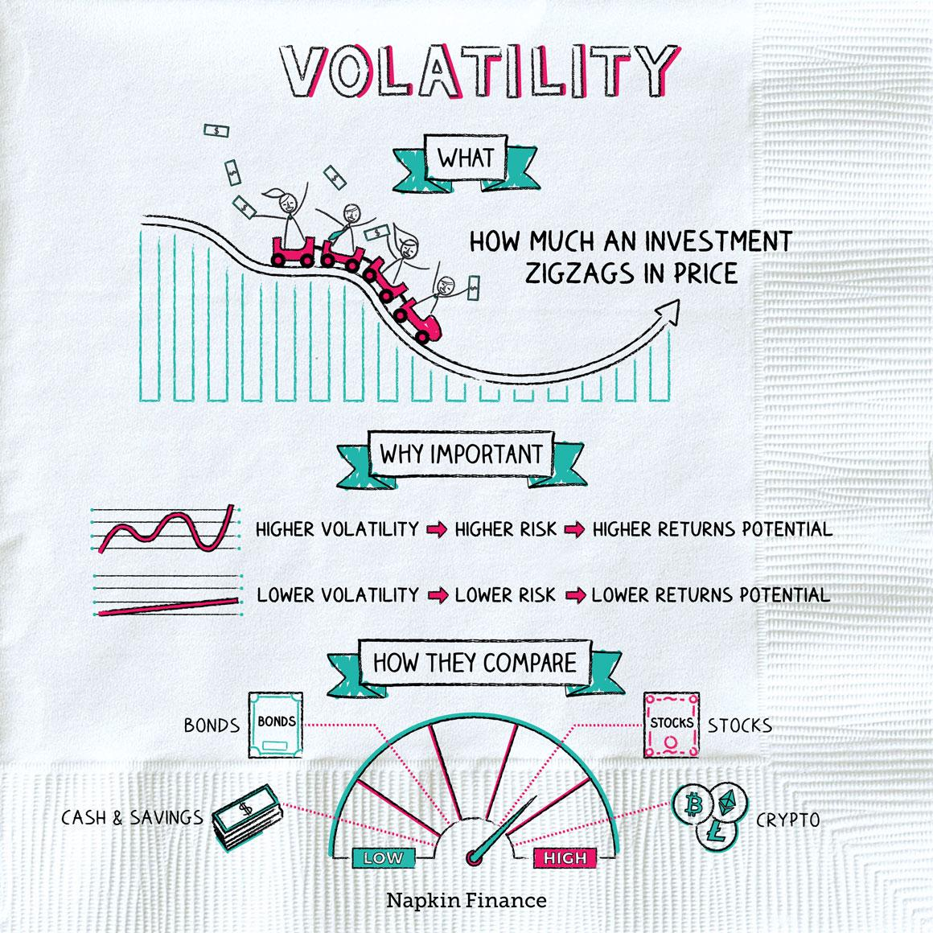
Volatility
Volatility is a statistical measure of the dispersion of returns for a given security
or market index. In finance, is often used to measure the risk of an investment or portfolio and in most cases, the higher the volatility, the riskier the security.
There are several ways to measure volatility.
The most commonly used methods are the standard deviation and the variance of the returns. The standard deviation is a measure of the dispersion of the returns around the mean, while the variance is the square of the standard deviation.
Volatility is measured by calculating the standard deviation of the annualized returns over a given period of time.
Some of the common reasons for the changes in volatility include:
Market conditions
Company-specific events
Investor sentiment
Volatility Clustering
Leverage effect

Slide 5
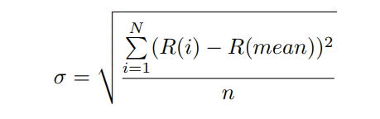

How to calculate volatility
There are several ways to alculate volatility of a financial time series, depending on the type of data and the specific use case. The most common method is standard deviation, that is computed as:
In our case, we have to calculate the standard deviation of two returns series.
To calculate the returns we implement the following formula:

Slide 6

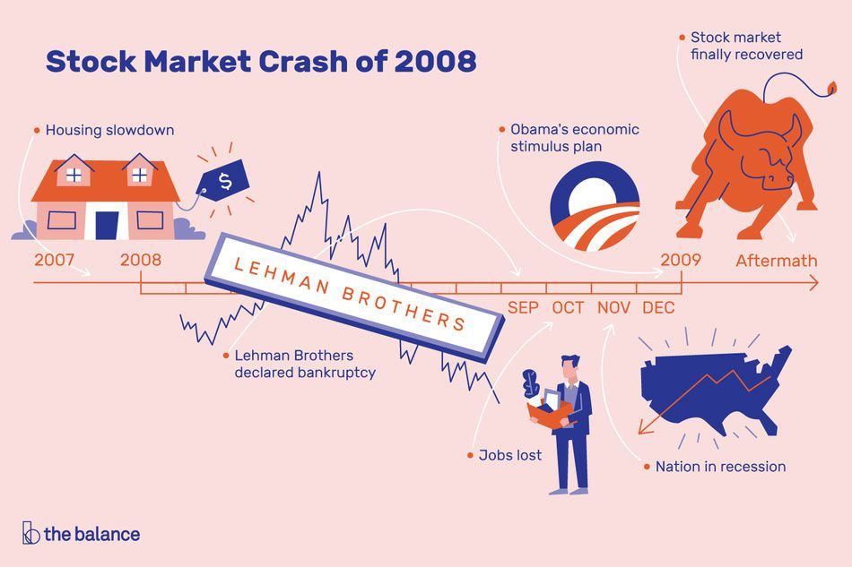
Historical context
The 2008 financial crisis was the worst economic disaster since the Great Depression of 1929. The crisis led to the Great Recession, where housing prices dropped more than the price plunge during the Great Depression.

Slide 7
Time series Analysis
Time series analysis is a powerful tool for understanding and predicting patterns in data over time.
It can be used to identify trends, seasonal patterns, and cyclic movements in data.
After choosing the French bank and the Index, thanks to the getSymbols() function of R, we have obtained historical financial data for the prices, selecting for both time series the closing prices for the period between the 1 January 2009 and the 31 December 2011.
After that, we calculated the returns of the two time series with the Calculate returns function and plotted the results shown in the next slide.

Slide 8
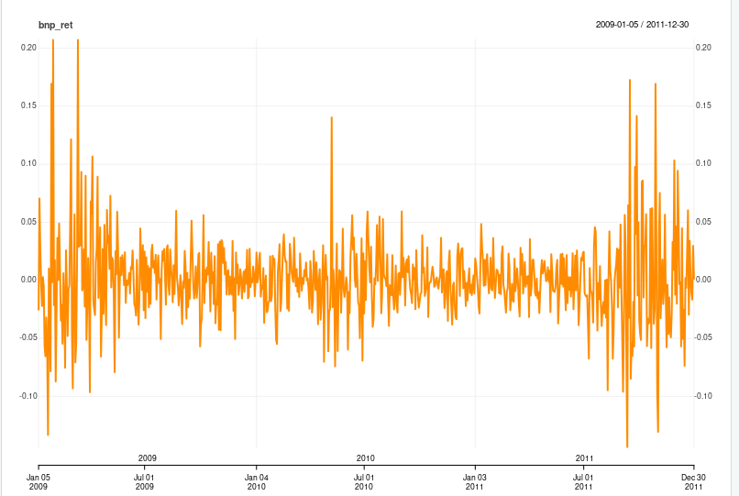
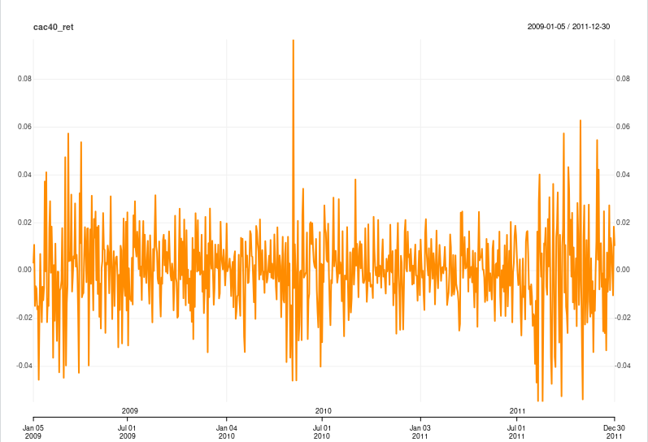
Our Analysis
As we can see from the two graphs, there is a significant increase in the variability of returns over the period 2009-2011, especially in the late part of 2011 and the early part of 2009. During the crisis, volatility of returns was really high, the peak for both time series is at the end of May 2010.
Despite the huge variability of returns, we have tested whether returns are stationary or not using the Augmented Dickey-Fuller test. The result of the test shows us a very small p-value that makes us reject the null hypothesis of non-stationarity. So our returns are stationary

Slide 9
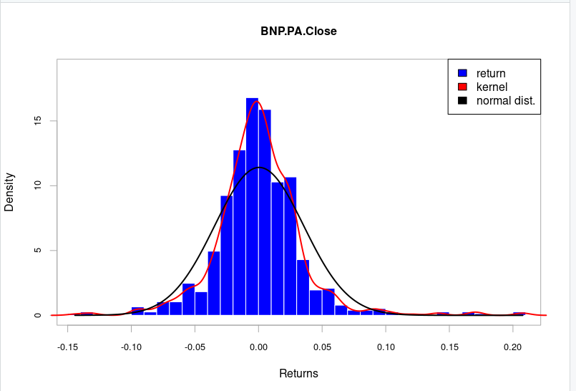
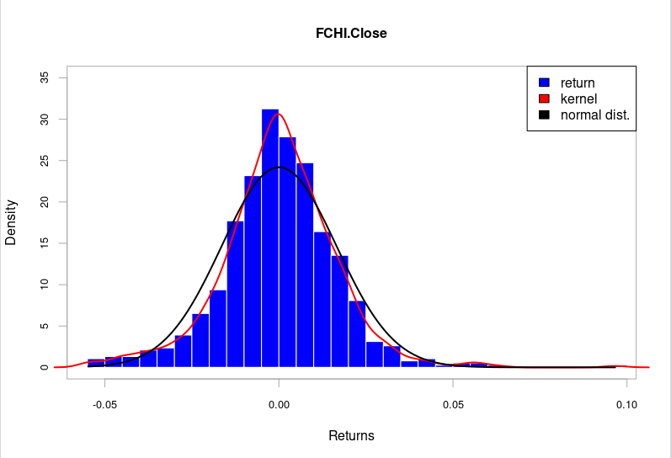
Then, after having analyzed the fluctuations of the returns during the crisis period, we created the histograms of returns for the two time series and we present the results with the two following graphs to our right.
As we can remark, neither BNP returns nor CAC40 are normally distributed. This is a crucial information for solving the exercise and to compute the equality of the two variances. The fact that returns are not normally distributed prevents us from using some statistical test available in R for the comparison of variances.
We also observe that both histograms are left-skewed.
In our code, thanks to the Shapiro test, we tested whether returns are normally distributed.
For both time series, we have obtained a very small p-value, meaning that we can reject the null hypothesis of normality of returns, so our time series are not normally distributed.

Slide 10
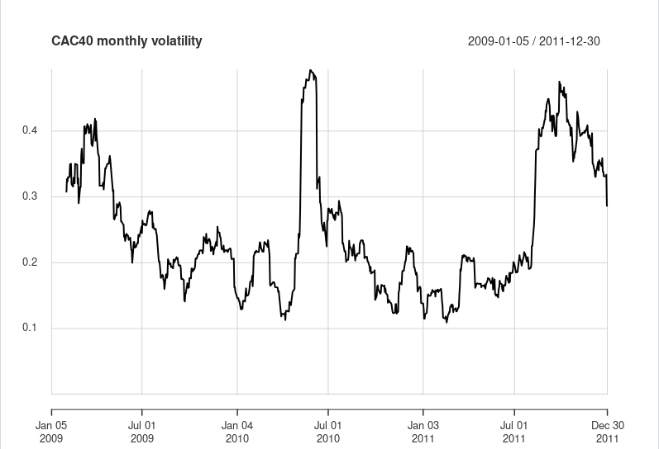
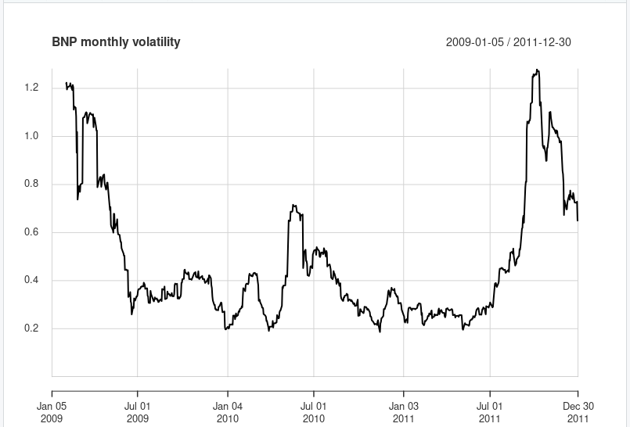
Volatility Analysis
Next we can find volatility analyses performed on BNP and CAC40.
How can we justify the spikes in volatility increases in early 2009 and late 2011?
According to the volatility paradox hypothesis, an environment of low yields and volatility could invite excessive risk-taking by financial investors.
1. First, risk aversion tends to decline during prolonged periods of low volatility as suggested by estimates of the volatility risk premium . A lower premium amounts to investors demanding less compensation for holding risky assets.
2. Second, low volatility mechanically compresses backward-looking risk measures, such as the value at risk (VaR), which shape investors’ risk management decisions.
This pro-cyclical behaviour of the VaR allows investors to increase their exposure to assets which are prone to bursts of volatility for a given risk threshold.
In conclusion, by overlaying these graphs we can express that there has indeed been an increase in volatility in the banking sector ( represented by BNP) but that this increase in volatility has manifested itself throughout the real economy (as we can see from the CAC 40 index)

Slide 11
Analysis of Squared returns
After having checked the graph of the volatility, we need to test whether the two volatilities are equal or not for
the time period under study. Before doing that, we have analyzed the correlation of the squared returns.
We have computed three correlation coefficients for the squared returns: the Pearson correlation coefficient, the Kendall correlation coefficient and the Spearman correlation coefficient.
All three coefficients range from -1 (perfect negative correlation) to 1 (perfect positive correlation), with 0 indicating no correlation. Pearson correlation coefficient measures the linear relationship between two variables:
if the coefficient value lies between ± 0.50 and ± 1, then it is said to be a strong correlation.; Kendall correlation coefficient measures the ordinal association between two variables while Spearman correlation coefficient measures the monotonic association between two variables.
For our data, Pearson correlation coefficient is 0.62 , so our time series of squared returns are highly correlated and we have to account for this problem when testing for the equality of variances.

Slide 12
Comparing variances of time series
There are several tests in R that can be used to compare the variances of two time series. Some examples include:
Bartlett’s test: The test is based on the chi-squared distribution and is sensitive to deviations from normality. Since our data are not normally distributed, we cannot use this test to compare the two volatilites;
Levene’s test: it is robust to deviations from normality and can be used when the sample sizes are not equal.
F-test: It can be used to compare the variances of two or more time series if they are independently normally distributed.
Fligner-Killeen test: It is based on the non-parametric rank method and is robust to deviations from normality.
Cochran’s Q test and Brown-Forsythe test: these tests are used to compare variances of more than two time series.
In order to deal with the squared return correlation, we decided to run a linear model regression of the squared returns on the returns of the two time series, in order to explain how the squared returns are affected by the simple returns.
We used the Breusch-Pagan test on the linear model created.
As a result, we have obtained a very small p-value, that leads us to reject the null hypothesis of equal volatility.
For this reason, we can affirm that the volatility of the banking sector was higher compared to the one of the other sectors.
More specifically, if we look for instance at the annual volatility of the year 2009, for the CAC 40 index we have a volatility of 26% while the volatility of the BNP is 63%. The result obtained from this test confirms us that the volatility of the banking sector was higher than the volatility of the other sector during the crisis period.

Slide 13
THANK YOU FOR YOUR TIME!
+

